Slide 1
BIT Manipulation b1nary representat10n
There are 10 kinds of people in this world:
Those who understand binary and those who don’t

Slide 2

A few things about me
AMAN BUCHA
An Arbitrary Guy
Final Year B.Tech. student, Maths Department
Delhiite (and hence foodie XD)
Former CP Head
ICPC Asia West Finalist
Weeb
Hobbies: Badminton, Flute, Poetry, Anime, Reading
Interests: Probability, Geography, Mythology, Linguistics

Slide 3
Basic Properties of Binary Representation
(…. d₃d₂d₁d₀)₂ = …2³d₃ + 2²d₂ + 2¹d₁ + 2⁰d₀
Number of digits in binary representation = 1 + [log₂(n)] = O(logn)
Number of trailing zeros represent the maximum power of 2 that divides the number
2^{x} = 1 + 2⁰ + 2¹ + …. 2^{x-1,} so 2^{x} > 2⁰ + 2¹ + …. 2^{x-1}
Repeatedly halving a natural number (and taking its GIF) will reduce it to 1 or 0 in O(logn) moves

Slide 4
An Old Problem: King and Wine
History is a set of lies agreed upon
–Napoleon Bonaparte
A king has m bottles of wine and a large number of prisoners. Exactly one of the bottles of wine is poisoned. The poison when taken has no effect on the person until exactly 24 hours later when the infected person suddenly dies..
The king wants to know which bottle of wine is poisoned in 24 hours. He decides to use the prisoners as taste testers to determine which bottle of wine contains the poison.
What is the minimum number of prisoners the king has to use to determine the poisoned bottle?

Slide 5
Problem: Indian Premier 2^{League}
Ee sala cup nahi
– Faf du Plesis
Suppose we change the rules of the IPL, the number of points a team gains if it wins its i^{th} match is 2^{i} (instead of 2)
RCB wins every match that DK plays and loses all others. But since DK is old, he may not be able to play all the matches due to fitness issues.
If DK plays the i^{th} match, his fitness drops by f_{i}. His initial fitness level is F_{T}. At any stage of the tournament, his fitness level should be non negative.
Determine the maximum number of points RCB can gain in the tournament.
Note: No rains occur in Indian Premier 2^{League}

Slide 6
Problem: Bihari babu CMU chale
Do your best and forget the rest
-GD
Merrily spending his last days in this college, our beloved Gunjan Dhanuka decides to update his research website*
His website has 1024 webpages. For each webpage, he wants to add hyperlinks to two different pages.
The links should be added in such a way that you can jump from any page to any other page by clicking at most 10 links
Help Gunjan to update his website
*Note : Don’t search for it if you don’t want depression

Slide 7
Problem: Amsterdam to Astana
Why settle? Travel, work and have fun
-DS
Working in Amsterdam, Dhruv Somani realises he has to travel to Astana to represent IIT Guwahati at the ICPC World Finals 2024
However, he has a strange array of n elements which changes each second, and would leave his room only when the array stops changing
In each second, the following happens:
b_{i}= a_{i} xor a_{i+1} (b_{n} = a_{n} xor a₁)
a=b
Will Somani be able to reach Astana?

Slide 8
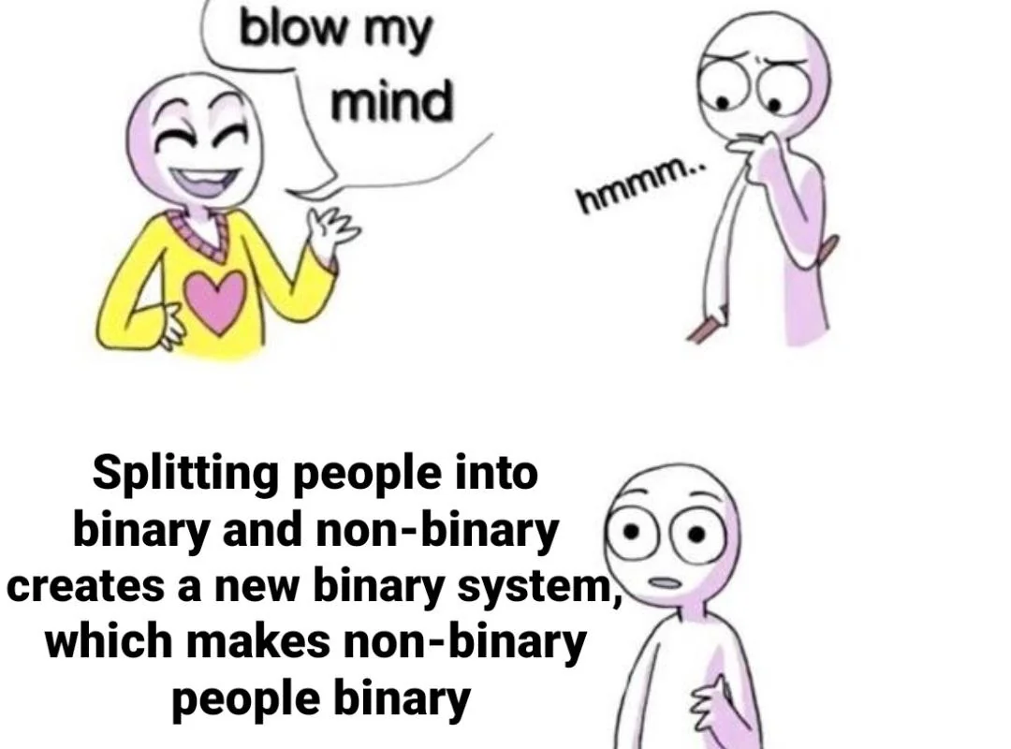
A common yet unnoticed technique
One’s reality might be another's illusion.
We all live inside our own fantasies
– Itachi Uchiha
Many of the common data structures and algorithms just involve checking if a particular bit is set in the binary representation of the optimal answer
Or maybe, you can precompute the answers of all powers of 2, and then construct the solution using them

Slide 9
Binary Search
If you haven’t found it, keep looking
-Steve Jobs
Given a non decreasing array, your task is to find for an element in the array
Linear Search can work in O(n) on any array but can we make use of the monotonicity of the array?
Search in range [l, r] by checking for middle element and keep on halving the interval length until you find the element
Time Complexity : O(logn)

Slide 10
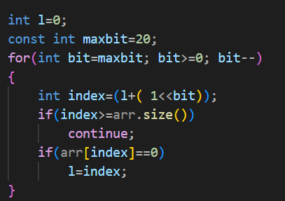
A different way to look at Binary Search
For each bit, check whether it can occur in the binary representation of the distance of optimal index from l
Suppose you are given an array arr, which consists of 0s followed by 1s. Then the index of the last 0 can be found from the following code, It is stored in the variable l

Slide 11
Exponentiation
Move fast. Speed is one of your main advantages over large competitors
- Sam Altman
Suppose you have to find a^{x}
What will you do?
a*a*a…. (x times)
Time complexity : O(x)
But what if x is large

Slide 12
Binary Exponentiation
Exponentiation in Logarithmic Time :)
Computation
Compute prod[j] = a^{2^j}
prod[0] = a
prod[j] = (prod[j-1])²
Time Complexity : O(log(x))

Slide 13
Binary Exponentiation – Solving
Suppose x = (1000101)₂
So x = 2⁶ + 2² + 2⁰
So a^{x} = a^{2^6} * a^{2^2} * a^{2^0}
The clearly , a^{x} = prod[6] * prod[2] * prod[0]
In general, multiply all the set bit indices of prod
Since many programming languages have an upper bound on the maximum number than can be stored, you will be asked to find the answer modulo some number

Slide 14
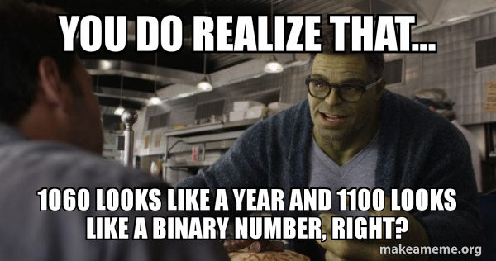
Applications
Inverse modulo some prime number
a^b^c modulo p
Matrix Exponentiation

Slide 15
Sparse Table
Why can't I try on different lives, like
dresses, to see which one fits best?
-Sylvia Plath
You are given an array arr. You are given q queries of the form [l, r] You have to find minimum of arr[l, r]
Answering all these queries in a naïve way will cost O(nq) which is costly
Can we do better?
We can do precomputation in O(nlogn) and answer the queries in O(q) or O(qlogn)

Slide 16
Sparse Table - Precomputation
Idea is to precompute dp[i][j] = minimum of all elements in the range [i, i+2^{j})
Clearly dp[i][0] = arr[i]
And dp[i][j] = min(dp[i][j-1], dp[i+2^{j-1}][j-1])
Time taken : O(logn) for 1 index , O(nlogn) for the entire array

Slide 17
Sparse Table – Answering queries
To answer queries for [l, r] check the binary representation of r-l
And answer the queries using set bits in the binary representation
Note that in case of minimum operation you can represent [l, r] as union of two segments of length some power of 2, and take their minimum

Slide 18
Sparse Table
The difference between stupidity and genius is that genius has its limits - Albert Einstein
Advantages
Disadvantages
Easy to implement
Min/Max found in O(1)
Can be used only on immutable arrays (Why?)
Most range query questions will involve updates :*)

Slide 19
Problem: Sharma and Shri
Interviews are like blind dates. You dress up, put your best foot forward, and pray they like you enough to see you again
-Anonymous
There are n candidates who interviewed to become the next CP head of the insti. Sharma and Shri assign the score of i^{th} candidate as a_{i}
Realising the first few candidates can have a better score due to the moody nature of Sharma, Shri decides to normalize the scores in an interesting way
He defines the new score of the i^{th} candidate as b_{i} = ((a_{i}% a_{i+1} )%a_{i+2})….%a_{n}
Help Shri find the array b efficiently
Constraints: n <= 10⁵, a^{i}<=10⁹

Slide 20
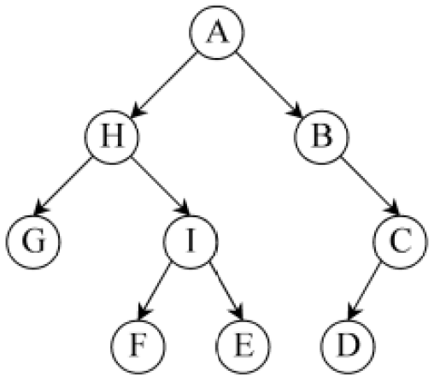
Binary Lifting – An intro to Trees
Lack of money is the root of all evil
-Mark Twain
A tree is a collection of n nodes and n-1 edges
We are interested in rooted trees
The topmost node is root
Some nodes may have children
Each node has exactly 1 parent, except root
You are given the parent of each node
You have to find the kth ancestor of a particular node

Slide 21
Binary Lifting - Solution
Similar to sparse table
Precompute the 2^{j} ancestor of each node in ancestor array, anc
So anc[i][0] = parent[i]
And anc[i][j] = anc [anc[i][j-1]] [j-1]
Now to answer the queries of the type ‘kth ancestor of node i’, just see the binary representation of k and compute

Slide 22
Application - Lowest Common Ancestor
Suppose you are also given the depths of each node
To find the LCA, first set the deeper node to its ancestor at the same depth as the shallower node
Approach 1 : Use binary search, but that will cost O(log²n). Can we optimize it?
Approach 2: For each bit j in decreasing order, check if the 2^{jth} ancestors of both the nodes are same or not. If not, set them to their ancestors
The parent of any of the nodes is the LCA
Time complexity : O(logn)

Slide 23
Problem : MnC vs CSE
Poor kids are just as bright and just as talented as white kids
-Joe Biden
In Algoland, there is a group of n friends. The homes of the friends are connected by n-1 roads. It is possible to visit any friend’s home from any other friend’s home. Thus the n houses form a tree
Each friend belongs to either MnC or CSE.
A student of MnC paints his house white while a CSE student paints his house black
You are given q queries. In each query, you will be given two friends. You need to determine the number of black houses in the path connecting their homes

Slide 24
THANK YOU

